Slide 1
Managing Telework

Slide 2
Objectives
Understand why telework is being offered as a short-term mitigation strategy to limit the spread of COVID-19 as it has come to Alaska.
Create
Create awareness of increased responsibility for supervisors and coworkers in a telework environment.
Build
Build your knowledge of supervising and managing in a telework environment.
Understand

Slide 3
Performance Management
Focus on results – not the activity.
Performance standards should be consistent for teleworkers and non-teleworkers.

Slide 4
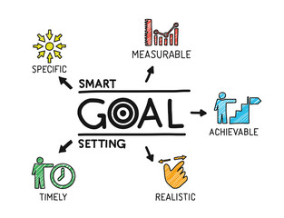
Performance Management
Establish SMART goals, outcomes and deliverables.
Agree on a plan for monitoring and self reporting outcomes and deliverables based on performance metrics.

Slide 5
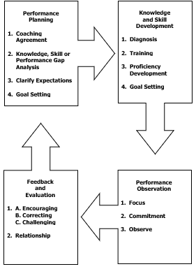
Performance Management
Provide timely, consistent coaching and feedback

Slide 6
Telework Tips
Set Clear Expectations
Monitor Performance
Stay Connected
Build a Trusting Environment
Manage by Results – Not Activity
Promote Team Cohesion

Slide 7
Telework Resources
5-Minute Report
Department Human Resources
Division of Personnel & Labor Relations webpage links
FAQs
Lynda.com
http://doa.alaska.gov/dop/recruitment/telecommuteFAQ/

Slide 8
Telecommute FAQs Page

Slide 9
5-Minute Report
http://doa.alaska.gov/dop/recruitment/telecommuteFAQ/

Slide 10
5-Minute Report
http://doa.alaska.gov/dop/recruitment/telecommuteFAQ/

Slide 11
Technology
Identify what equipment is needed for teleworkers
Hardware, Software and Security Protocols
Access to State databases and shared resources
VPN – Virtual Private Network
Internet connectivity and confidentiality requirements
Telephone usage

Slide 12
Questions
What are your questions?
Your questions will help us add to the online FAQs.

Slide 13
What’s Next?
Stay tuned for additional training and resources.
Prepare your telework plan with your team.
Work with your department leadership, Human Resources; and OIT teams.
Implement approved, effective and efficient telework plans.

